Slide 1
Identifying 3D Radiative Cloud Effects Using MODIS Visible Reflectance Measurements
Amanda Gumber
Department of Atmospherics and Oceanic Sciences/CIMSS
University of Wisconsin-Madison
Michael Foster
CIMSS, University of Wisconsin-Madison
NOAA NESDIS CoRP Symposium 2014

Slide 2
Motivation
Most GCM grid cells are larger than the scale of individual clouds, which impacts sub-grid scale radiation fields
Properties of cloud morphology are absent from solar radiative transfer in GCMs as well as satellite retrieval algorithms
Notes:
The motivation for this work stems from the representation of clouds in global climate models. Often the grid cells of gcms are larger than the actual cloud or clouds they contain and simplifications of cloud properties are used which affects the sub-grid radiation fields. Also, properties of cloud morphology are usually absent from solar radiative transfer in both gcms and satellite algorithms. This leads to simplification of cloud microphysical properties as homogenous and neglect of sub-grid scale variability, which can cause errors in models resulting in biases for cloud feedback processes.

Slide 3
Effects of Cloud Heterogeneity
Internal cloud heterogeneity
Plane-parallel albedo bias = Independent Column Approximation(ICA) – Plane Parallel calculations
Horizontal distributions of in-cloud properties
External cloud heterogeneity
“ICA Bias”= 3D RT calculations – ICA calculations
Horizontal photon flow, leakage through cloud sides, cloud shadowing, enhanced cloud illumination, solar zenith angle dependence
Notes:
A common and most computationally easy calculations done are using a plane parallel assumption, which ignores horizontal transport and simply travels through a vertical layer. This assumption causes room for biases due to clouds not always being homogenous
From representing cloud properties as homogenous, there are a few biases that can be formed. Many models use a single mean value for representing in cloud properties such as liquid water content. Throughout a cloud, this is obviously not a truly accurate representation. This causes a bias refered to as the plane parallel albedo bias which takes the difference between an approach called the independent column approximation and the standard plane parallel calculations. The independent column approximation breaks a grid cell into a lot of smaller cells and calculates the cloud properties for each one, essentially creating a distribution of the in cloud micro phsyical properties.
External cloud heterogeneities are caused by variability in cloud morphology such as number and distribution of clouds in a grid cell, cloud shape, and cloud size. This heterogeneity also accounts for horizontal photon flow between grid cells, photons exiting or leaking through the cloud sides, cloud shadowing and enhanced areas of illumination and have solar zenith angle dependence. This bias can be unoffically called the ICA bia, which is the difference between the 3d radiative transfer model calculations and the ica calculations, since the ica calculations do not take into account horizontal energy transport.

Slide 4
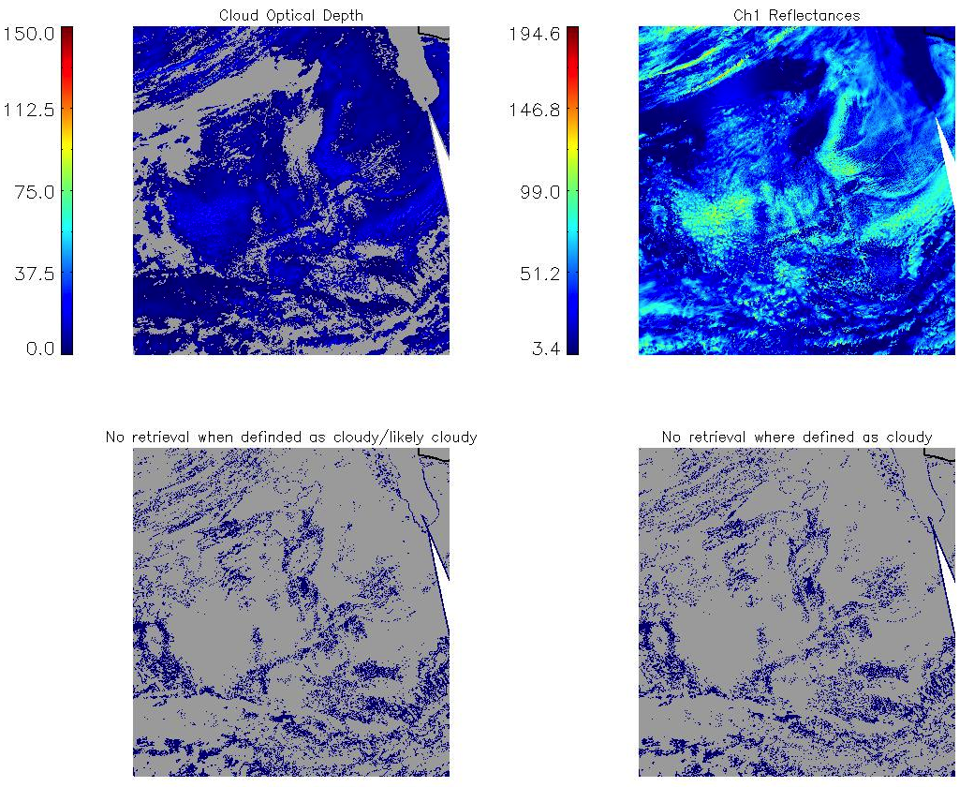
Notes:
For this study, we are using modis data given it is a very effective way of viewing clouds and cloud scenes and has a decent time span of records. Though there is a potential instrument bias from how the modis processing algoritum makes optical retrievals. In the first row I have plotted the modis retrived optical depth along with the channel 1 0.65 reflectances. In the second row, I have plotted where the MODIS cloud mask has defined a pixel as cloudy or likely cloudy, but there is no optical retrival taken for it and then just the where the cloud mask has defined the pixel as cloudy, but no retrival has been taken for it. This type of pixel filtering often happens to optically thin clouds or along cloud edges. This results in skewing the overall distributions of cloud properties.

Slide 5
Liquid water path retrieval within a 1x1 degree grid box
Mask Method
Fit Method
Calculate mean, minimum, and variance of liquid water path using cloud mask and successful optical depth and droplet effective radius retrievals
Calculate coefficients for fit function between successful optical depth retrievals and observed visible reflectance
Apply fit function to entire suite of visible reflectance measurements to get total-scene distribution of optical depth
Convert optical depth distribution to liquid water path distribution and calculate statistical moments
Use statistical moments to generate Gamma/Gaussian distributions of liquid water path
Convert liquid water path distribution to visible reflectance and integrate to calculate mean
Modified from Foster et al., 2011
Notes:
To address this issue, we use a method published in a paper by Foster et all 2011 that generates distributions of in-cloud microphsyical properties which restores these portions of clouds which are often neglected and conserves the satellite measured solar reflectance. For this methodology which I will be refereing to as the fit method from now on, a fit function is developed which relates sucessful cod retrivals and the corresponding visible reflectance measurements. The fit function is then apprlied to all visible reflectance measurements to get a total scene distribution of cod. Using grid averaged values of ccn and condensation rate, distribution of cod is converted to lwp as described in a paper from bennartz 2007. From this– SWITCH TO NEXT SLIDE– The resulting distribution from the cloudy portion of the sky is used to generate a gamma distribution of liquid water path from the calculated statistical moments. The using another equation from bennartz 2007 the liquid water path distribution can be converted into visible reflectance and integrated to calculate the mean visible reflectance over the entire scene. This can similarly be applied to pixel filtering methods, which I will refere to as the mask method. Instead of using a fit functions to generate distributions of liquid water path, statistical moments are derived from using only valid retrieved values.

Slide 6
median R_{vis} for clear sky
frequency of occurrence
clear sky
cloudy sky
visible reflectance
From Foster et al, 2011.
Notes:
From this a normal distribution around the mean clear sky reflectance is used to approximate a threshold betweeen the clear and cloudy portions of the scene—go back

Slide 7
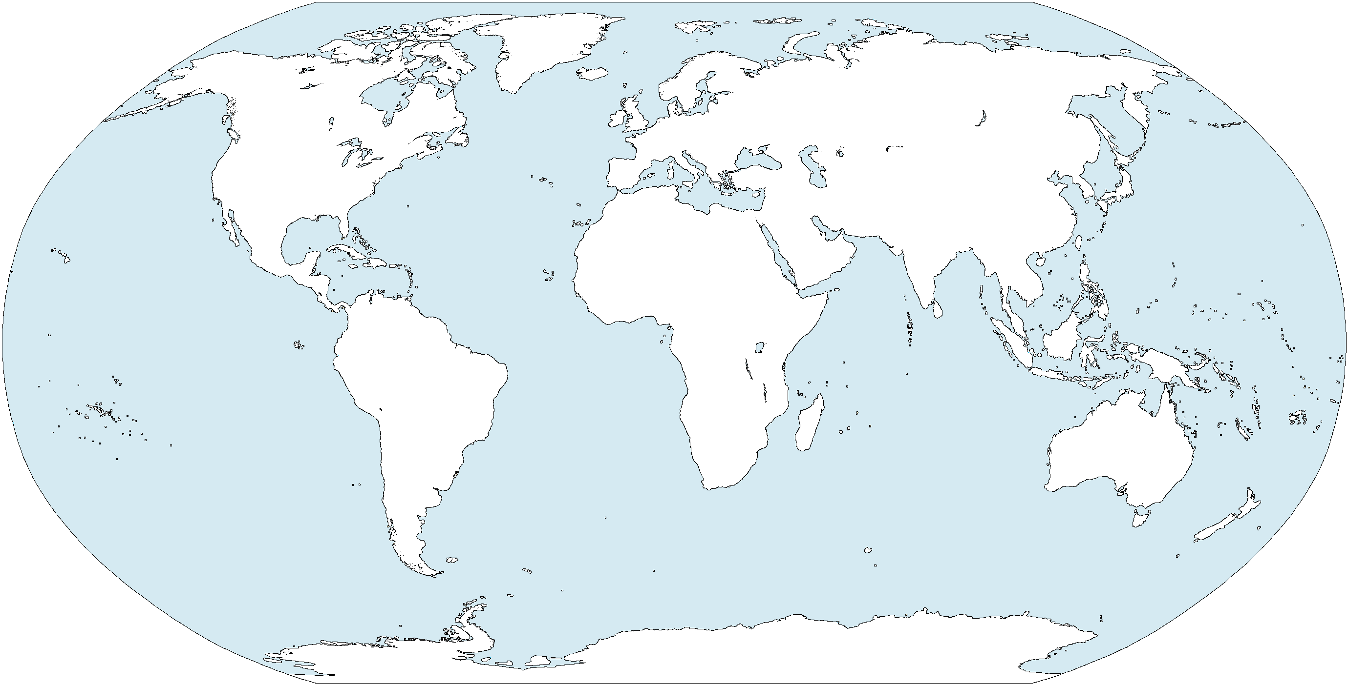
Areas of Study
Notes:
For this study, we are using three areas over the ocean which are either 20x20 degrees or 30x 20 degrees over the ocean only looking at liquid clouds. The ocean area is used since maritime water clouds are known to regulate a large portion of the earth’s energy budget and are important for the incident solar radiative field.

Slide 8
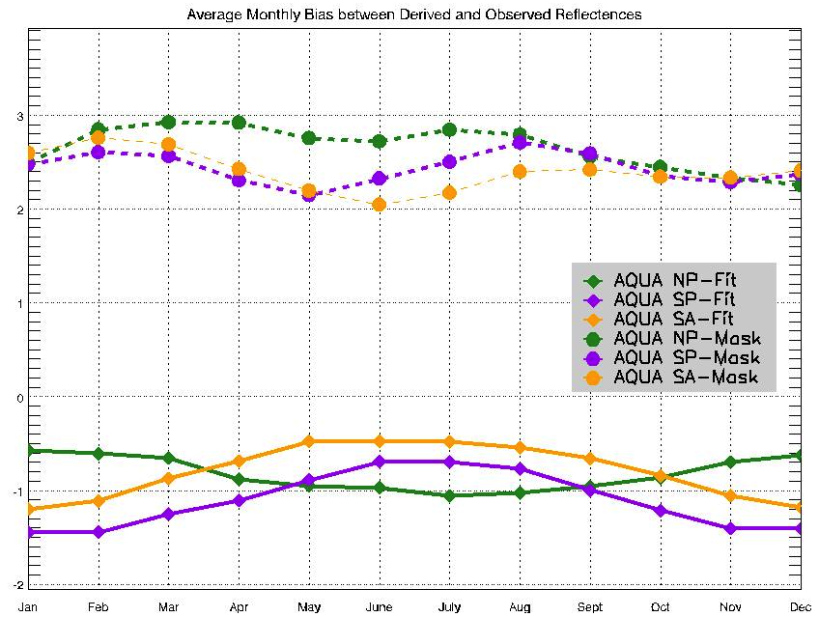
Notes:
These are monthly averaged biases for Aqua between the derived reflectance from the method I just explained and the observed reflectances. The top dotted lines are using the Mask method over the three ocean regions. As we can see, they all correspond to positive biases ranging between two and three. The bottom solid lines are using the fit method over the same ocean regions. Overall, there is a negative bias for the fit method, but the average values are range between -1.5 to -0.5 which shows there is more accuracy in comparison to mask method. The fit method also seems to show a seasonal bias. For the northern hemisphere, the north pacific ocean area has less of a negative bias in december, january, and feburary, and reaches the largest amount of bias in june july and august. Where as in the southern hemisphere the south pacific and south atlantic regions show a smaller bias in JJA and a larger bias in DJF.

Slide 9
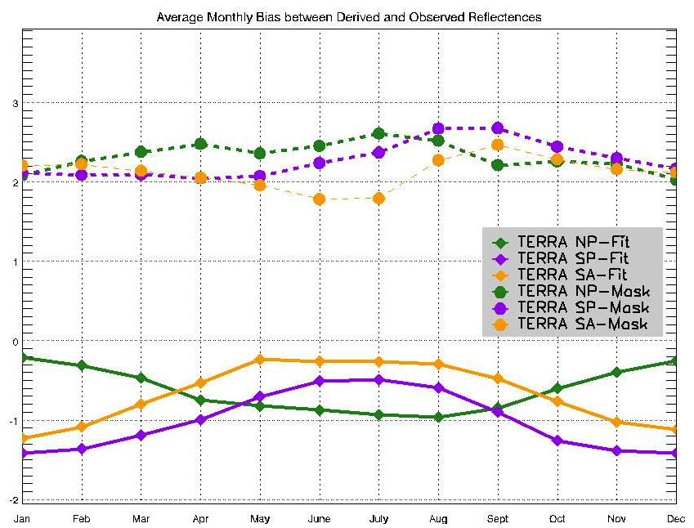
Notes:
This is the same plot except for using Terra which is the satellite with an afternoon crossing time. Terra is very similar to Aqua with the fit method showing a lower bias than the mask method, along with the same seasonal cycle being show between the nothern and southern hemispheres. Though it’s a bit hard to see, if you go back and forth between the plots, terra has an over all smaller bias for both the mask and the fit method.

Slide 10
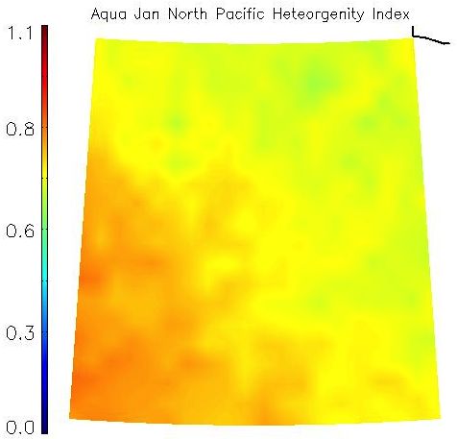
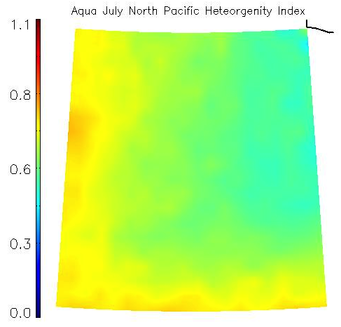
Identifying Heterogeneity
H_{σ}= σ / R_{vis} , Liang et al., 2009
Notes:
Though from the fit method we can create horizontal distrbutions of liquid water path, we cannot fully make distinctions between internal and external cloud heterogeneity. We will also be using a second metric to help for identifying the portion of the 0.65 reflectance attributable to cloud heterogeneity. The idea of this is to help quantify the effects of 1d radiative transfer on 3d cloud fields. It is important to note that many studies that have either simulated internal heterogeneity through the ICA calculations or external heterogeneity through monte carlo 3d rt calculations have only been over a small number of scenes and only for a finite number of cloud field realizations. Though the advantage of this controls the potential sources of bais, the disadvantage is being able to only apply the results to a narrow number of scenes. We will be applying the 3d RT simulation over a large variety of scene throughout the MODIS record for difference cloud heterogeneities and solar zenith angles to quanitfy biases in terms of H, to account for the magnitude of biases in the satellite data.
We use a metric from Liang et al 2009 which proposes a cloud homogeniety identification algorithum as the standard deviation of the reflectance of the region divided by the mean reflectance over the area. We applied this metric over all of our ocean regions. The higher the number is it is more representative of heterogenous clouds. For the north pacific, January showed a greater amount of heterogeneity in comparison to July.

Slide 11
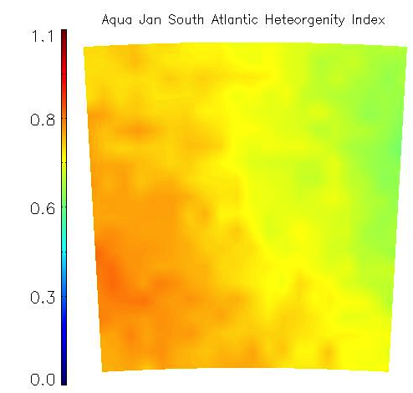
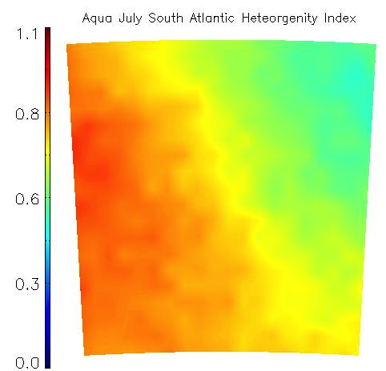
Notes:
Where as the South Atlantic region shows a greater amount of heterogeniety in July, although there is a larger gradient

Slide 12
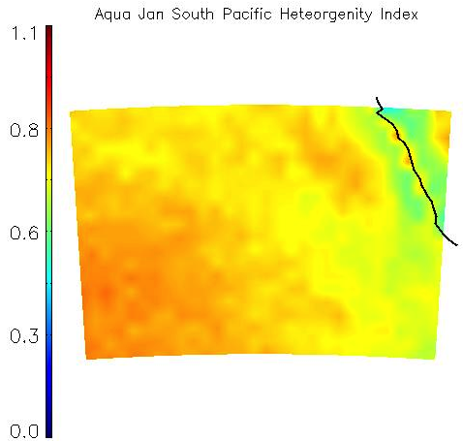
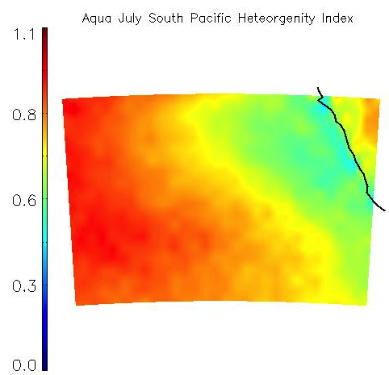
Notes:
The same is similar for south pacific. These figures seem to indicate that there is possibly a season indication of cloud heterogeniety amooung these regions, but there is future analysis to be done.

Slide 13
Current Work
Estimate locations of significant 3D effects using H_{σ}, solar zenith angle, sensor zenith angle, and visible reflectance measurements
Perform a large range of 3D RT calculations using I3RC Monte Carlo Model to compare against plane parallel and ICA calculations
Identify magnitude of solar reflectance that are attributable to internal and external heterogeneity

Slide 14
References
Bennartz, R.(2007), Global assessment of marine boundary layer cloud droplet number concentration from satellite, J. Geophys. Res., 112, D02201
Foster M.J., Ralf Bennartz, and Andrew Heidinger, (2011), Estimation of Liquid Cloud Properties that Conserve Total-Scene Reflectance Using Satellite Measurements. J. Appl. Meteor. Climatol., 50, 96–109.
Liang, L., L. Di Girolamo, and S. Platnick (2009), View-angle consistency in reflectance, optical thickness and spherical albedo of marine water-clouds over the northeastern Pacific through MISR-MODIS fusion, Geophys. Res. Lett., 36, L09811

